Slide 1
P.Rekha Sucharitha 192525342 CSA1406-Compiler Design

Slide 2
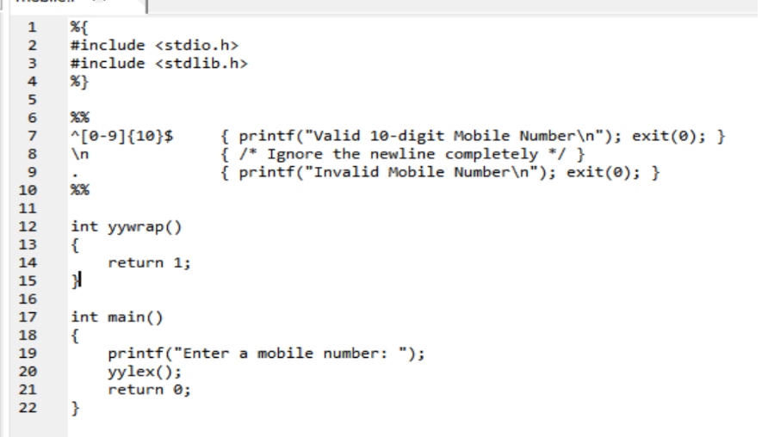
Mobile number validator

Slide 3
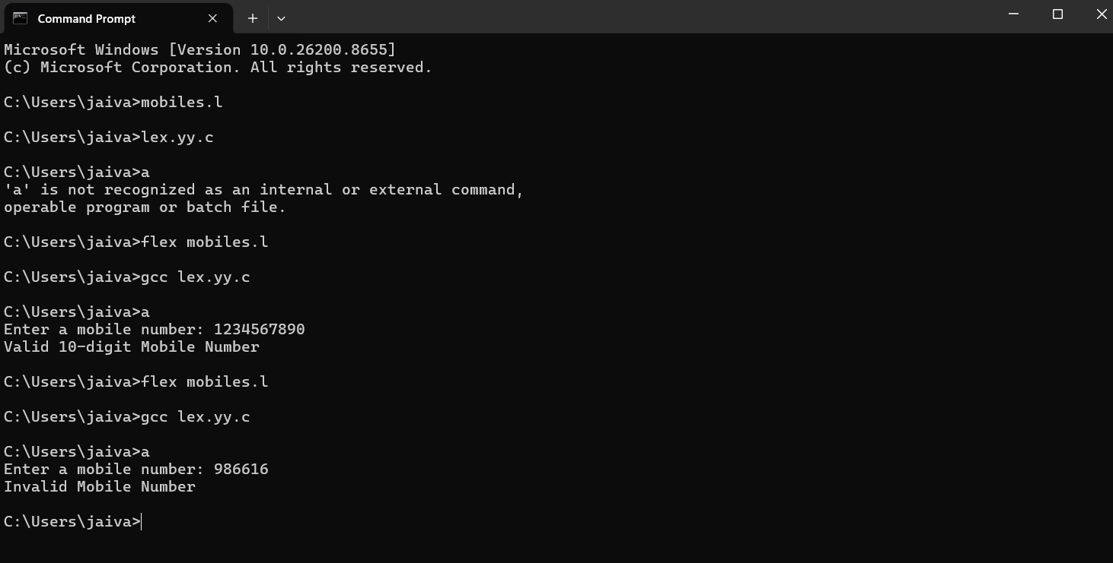

Slide 4
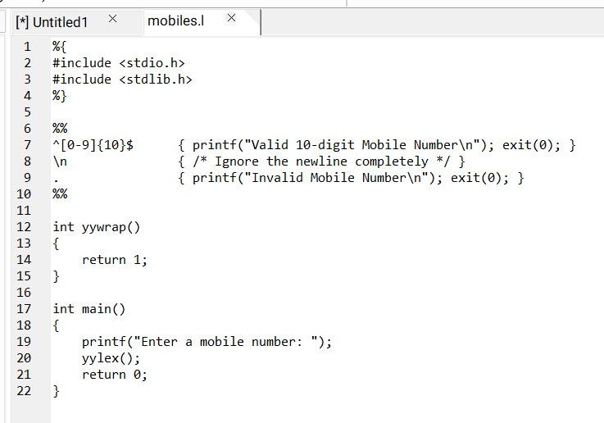
2.Digit or Not a Digit Detector

Slide 5
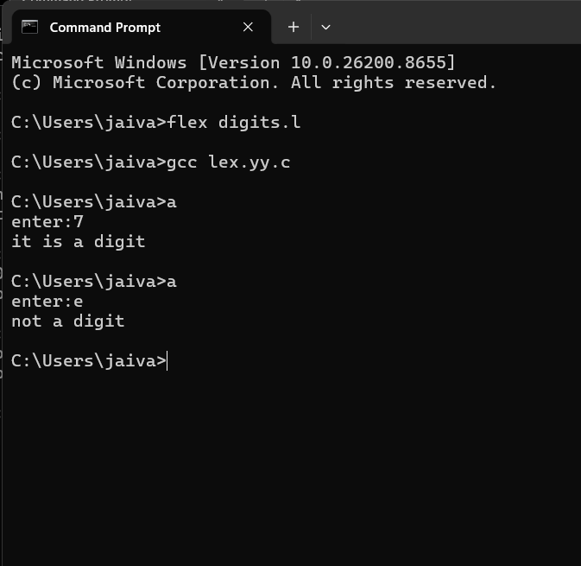

Slide 6
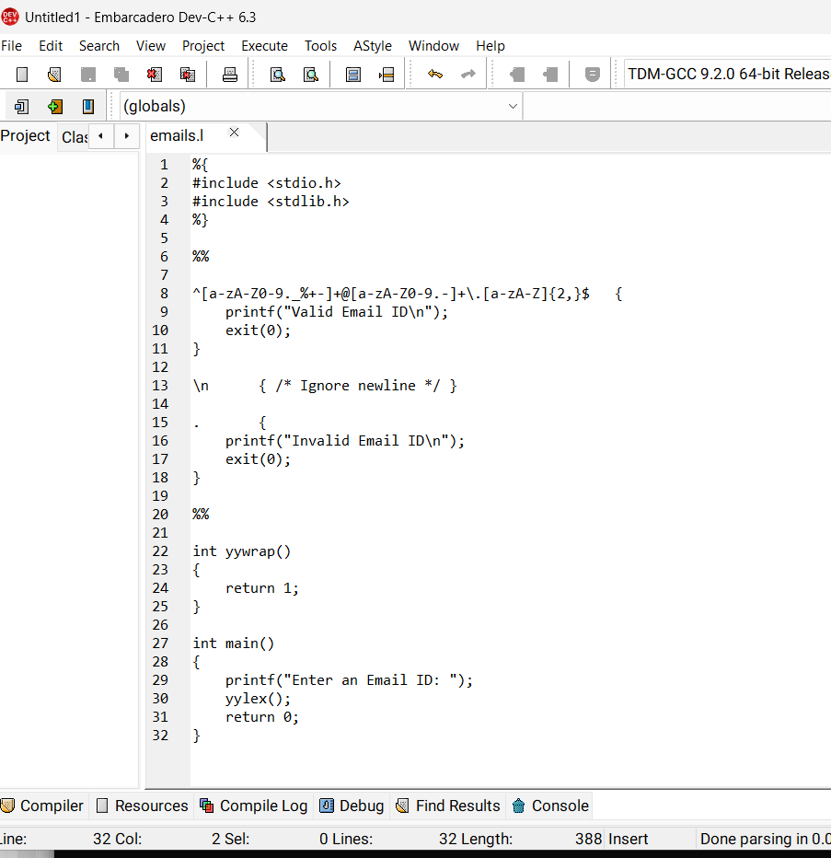
3.Email-ID Validator

Slide 7
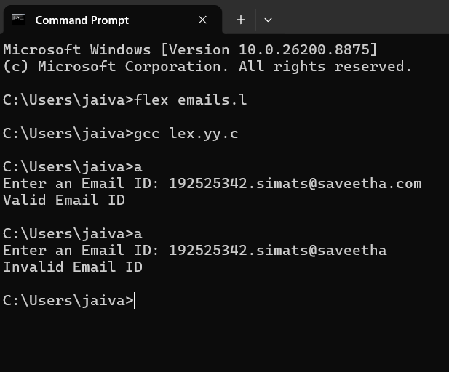

Slide 8
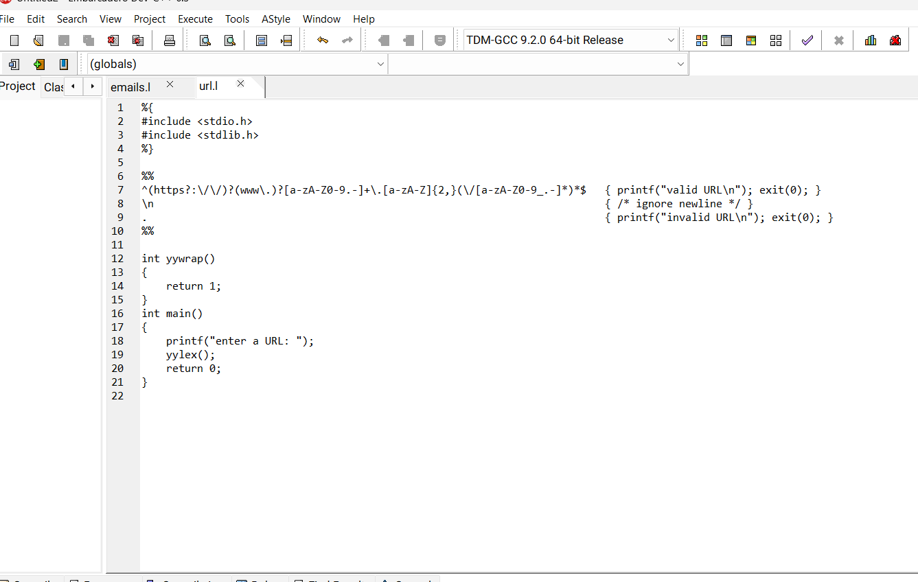
4.URL Validator

Slide 9
